Slide 1
Valentine’s Cup
CSE 496
Preliminary Meeting – 1st Presentation
Yakup Talha Yolcu
Project Advisor: Doç. Dr. Mehmet Göktürk
April 2023

Slide 2
Contents
Project Definition
Project Design and Plan
Timeline
Project Requirements
Success Criterias
Resources and References

Slide 3
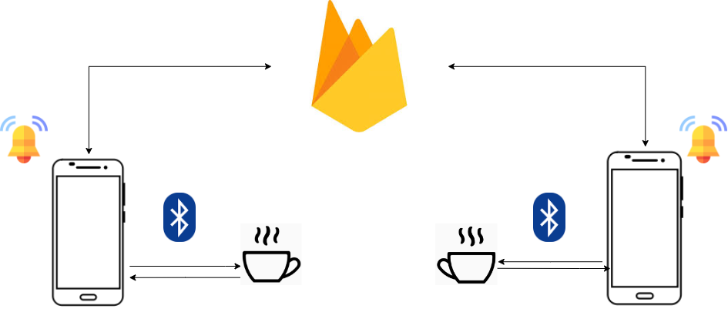
Project Definition
In this Project, there are two valentines connected to their individual cups via bluetooth.
When one drinks from their coffee or fills the cup, other Valentine’s phone plays a song.

Slide 4
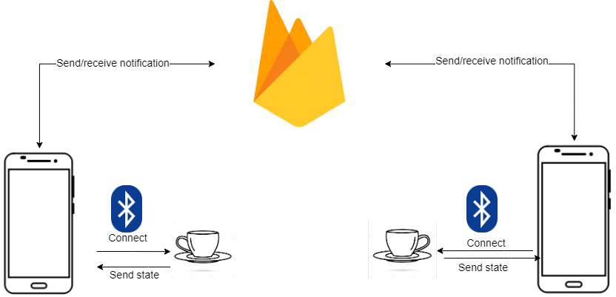
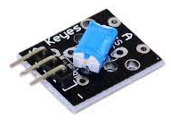
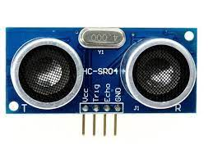
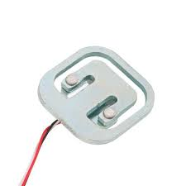
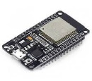
Project Design and Plan
Each cup has ESP32, load sensor, ultrasonic distance sensor and switch tilt sensor underneath. ESP32 will connect the each phone via bluetooth. ESP32 will send the current state of the cup periodically.

Slide 5
Timeline
10.04-23.04 | 24.04-07.05 | 08.05-21.05 | 22.05-04.06 | 05.06-18.06
Getting ready hardware Creating mobile app project Creating firebase database | Making connection of app with database Communicate sides between each other Set up hardware without bluetooth | Complete bluetooth communication between hardware and phones | Run tests | Talk with advisor, learn additional requirements/changes

Slide 6
Project Requirements - 1
Firstly I need to buy necesarry hardwares which will be explained in next page.
I need to set the hardware up properly and hardware should communicate with the app via bluetooth.
I need to have an app that takes data from phones bluetooth and depend on the determined state sends it to the real time database.
This app also should send notification to other Valentine when needed.

Slide 7
Project Requirements - 2
Hardware: ESP32 microcontrollers, load cell sensors, tilt sensors, ultrasonic distance sensors, and cups with appropriate platform to hold the sensors.
Software: C++ for ESP32 firmware and Flutter-Dart for mobile app development, and libraries for Bluetooth communication and Firebase Cloud Messaging.
A mobile app that can display real-time sensor data, send and receive notifications, and allow users to control the system.
Power supply: Batteries or a power adapter to power the ESP32 and sensors.
Cloud messaging service: A Firebase Cloud Messaging account to enable notifications to be sent and received between the two phones.

Slide 8
Success Criterias
Sensor accuracy
The load cell sensor, tilt sensor, and ultrasonic distance sensor must be accurate and provide reliable data to the ESP32, ensuring that the weight, angle, and distance measurements are precise and consistent.
Bluetooth connectivity
The ESP32 must establish a stable Bluetooth connection with the phone and ensure that sensor data is transmitted accurately and in real-time.
Cloud messaging
The system must be able to send and receive notifications via Firebase Cloud Messaging.

Slide 9
Resources
https://chat.openai.com
https://cdn4.iconfinder.com/data/icons/google-i-o-2016/512/google_firebase-2-512.png
https://upload.wikimedia.org/wikipedia/commons/thumb/d/da/Bluetooth.svg/1342px-Bluetooth.svg.png
Draw.io for designs

